Slide 1
B
Boosting Algorithms
AdaBoost | XGBoost | LightGBM
Concepts, Intuition & Comparison — No Fluff
2026 EDITION

Slide 2
01
SECTION ONE
What is Boosting?
The intuition behind turning weak models into powerful predictors

Slide 3
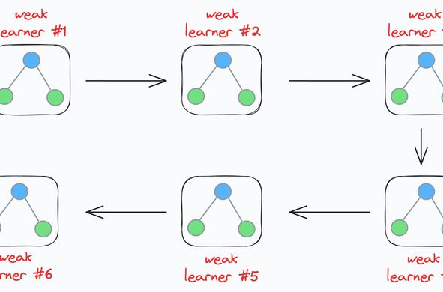
The Core Idea: Weak Learners → Strong Learner
Boosting is an ensemble technique that combines multiple weak learners — models only slightly better than random guessing — into a single powerful predictive model. Instead of training models independently, boosting trains them sequentially, where each new model focuses on correcting the errors made by the previous ones.
Think of it like a team of average students: individually they might score 55%, but when they collaborate and each focuses on what the others got wrong, the team can achieve 95%+.
The key insight: you don't need complex base models. Even simple decision stumps (single-split trees) can produce state-of-the-art results when boosted.

Slide 4
How Boosting Works — Step by Step
✦
1. Train a Weak Learner
✦
2. Identify Mistakes
Train the first base model (usually a decision stump) on the full training data. This model will make many mistakes, but that's expected.
Evaluate the model and identify which samples it misclassified or predicted poorly. These are the hard examples the next model needs to focus on.
✦
3. Train Next Learner on Errors
✦
4. Combine Predictions
Train the next model giving more weight/attention to the previously misclassified samples. This new model specializes in the hard cases.
Aggregate all models' predictions (weighted vote or weighted sum). Each model's contribution is based on its accuracy — better models get more say.

Slide 5
Boosting vs. Bagging vs. Stacking
Method | Training | How It Combines | Reduces | Examples
Boosting | Sequential — each model learns from previous errors | Weighted sum/vote of all models | Bias (primarily) | AdaBoost, XGBoost, LightGBM
Bagging | Parallel — each model trains independently on bootstrapped data | Average or majority vote | Variance (primarily) | Random Forest, Bagged Trees
Stacking | Parallel — base models train independently | A meta-learner learns optimal combination | Both bias & variance | Stacked Generalization
Voting | Parallel — diverse model types train independently | Simple majority vote or average | Neither specifically | Voting Classifier/Regressor

Slide 6
Key Properties of Boosting
✦
Reduces Bias
⚠
Prone to Overfitting
By iteratively correcting errors, boosting transforms high-bias weak learners into low-bias strong learners. This is why boosting works so well with simple models like decision stumps.
Since each new model focuses on hard examples, boosting can overfit to noise. This is especially true with noisy data. Regularization and early stopping are critical.
◔
Sequential Training
♛
Competition Dominance
Models must be trained one after another — each depends on the previous model's errors. This makes boosting harder to parallelize compared to bagging methods like Random Forest.
Boosting algorithms (especially XGBoost and LightGBM) have dominated structured/tabular data competitions on Kaggle for years, consistently outperforming deep learning on tabular tasks.

Slide 7
SECTION TWO
02
AdaBoost
Adaptive Boosting — The Pioneer of Boosting Algorithms
1995 — FREUND & SCHAPIRE

Slide 8
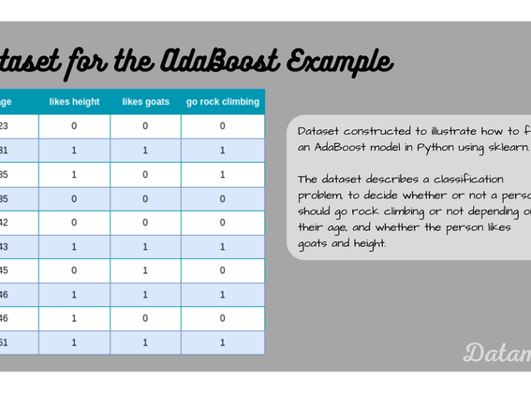
What is AdaBoost?
AdaBoost (Adaptive Boosting) was the first successful boosting algorithm, introduced in 1995 by Yoav Freund and Robert Schapire. It won the Gödel Prize for its theoretical significance.
The core mechanism: after each weak learner is trained, AdaBoost increases the weights of misclassified training samples and decreases the weights of correctly classified ones. The next weak learner then focuses more on the hard examples.
Each weak learner is assigned a weight (alpha) based on its accuracy. More accurate learners get higher weights in the final vote. The final prediction is a weighted majority vote of all weak learners.
Base model: Decision stumps (trees with a single split) are the default and work surprisingly well.

Slide 9
How AdaBoost Works — The Complete Loop
1
▤
STEP 1
Initialize Equal Weights
All training samples start with equal weight: w_i = 1/N. Every sample matters equally at the beginning.
2
✿
STEP 2
Train Weak Learner
Fit a decision stump to the weighted training data. The stump finds the single best feature and threshold to split on
⊗
STEP 3
3
Calculate Error & Alpha
Compute weighted error rate. Calculate alpha (model weight): lower error = higher alpha. If error > 0.5, flip predictions.
STEP 4
4
⇅
Update Sample Weights
Increase weights for misclassified samples, decrease for correct ones. Normalize weights so they sum to 1. This makes the next learner focus on hard examples.
✦
STEP 5
Repeat & Combine
5
Repeat steps 2–4 for T rounds (typically 50–500). Final prediction = sign of weighted sum of all weak learners' predictions. Each learner's vote is weighted by its alpha.

Slide 10
AdaBoost — Cheat Sheet
Key Hyperparameters
When to Use AdaBoost
When NOT to Use
n_estimators
Highly noisy data — AdaBoost will overfit to noise.
Number of weak learners (default 50). More = better but risk overfitting.
Binary or multiclass classification problems.
When you want a simple, interpretable boosting baseline.
Very large datasets — training is sequential and slow.
learning_rate
Shrinks each learner's contribution (default 1.0). Lower = more robust, needs more estimators.
When the data is relatively clean (low noise).
When you need feature importance or custom loss functions.
When model interpretability matters (stumps are easy to explain).
Regression tasks — limited support compared to XGBoost/LightGBM.
base_estimator
The weak learner type (default DecisionTreeClassifier with max_depth=1).
algorithm
SAMME.R (real-valued) vs SAMME (discrete). Use SAMME.R for probabilistic outputs.

Slide 11
AdaBoost — Strengths & Limitations
👍
Strengths
👎
Limitations
✓
Simple to understand and implement
✕
Highly sensitive to noisy data and outliers (they get maximum weight).
✓
No hyperparameter tuning needed to get decent results (works well out of the box).
✕
Sequential training makes it slow — cannot be parallelized like Random Forest.
✓
Theoretically grounded — strong mathematical guarantees on training error.
✕
Can be outperformed by gradient-based methods (XGBoost, LightGBM) on most tasks.
✓
Versatile — works with any weak learner, not just decision stumps.
✕
Limited loss function support — only exponential loss for classification.
✓
Built-in feature selection — misclassified samples guide focus, indirectly weighting important features.
✕
Does not handle missing values natively — requires preprocessing.
◆
Key answer: AdaBoost is the foundation — explain it first, then contrast with XGBoost to show depth.

Slide 12
SECTION 03
03
XGBoost
Extreme Gradient Boosting — The Industry Standard
2014 — TIANQI CHEN

Slide 13
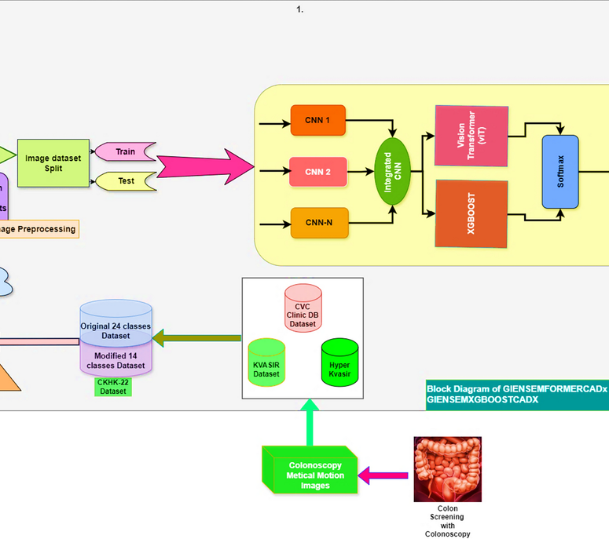
What is XGBoost?
XGBoost (Extreme Gradient Boosting) is an optimized, distributed gradient boosting library designed for efficiency, flexibility, and portability. It has been the go-to algorithm for structured/tabular data since 2014.
Unlike AdaBoost which uses exponential loss, XGBoost uses gradient boosting: each new tree is fit to the negative gradient (residuals) of the loss function. This makes it compatible with any differentiable loss — MSE, log loss, custom losses.
XGBoost introduced several key innovations that made it dramatically faster and more accurate than previous boosting implementations: L1/L2 regularization, tree pruning, sparsity-aware learning, and hardware-level optimization.
It supports parallelization at the feature level (not the tree level), making it significantly faster than AdaBoost while being more robust to overfitting.

Slide 14
Key Innovations That Made XGBoost Dominant
✦
Regularization (L1 + L2)
✂
Tree Pruning (max_depth)
▦
Sparsity-Aware Learning
XGBoost adds L1 (lasso) and L2 (ridge) penalty terms to the objective function, penalizing complex trees. This prevents overfitting — a major weakness of earlier boosting methods.
Natively handles missing values and sparse data. Learns the default direction for missing values during training. No imputation needed — a huge practical advantage.
Uses a depth-first approach with a post-pruning strategy. Grows trees to max depth then prunes backward. The gamma parameter controls the minimum loss reduction required for a split.
✦
Hardware Optimization
⚙
Custom Loss Functions
⛨
Built-in Cross-Validation
Cache-aware access patterns, out-of-core computation for datasets larger than RAM, and parallelization across CPU cores at the feature-split level.
Supports any differentiable loss function (logistic, squared error, Huber, custom). Pass your own gradient and hessian — unmatched flexibility.
cv() method allows early stopping based on validation performance. Prevents overfitting by finding optimal number of trees automatically.

Slide 15
Understanding the XGBoost Objective
The Training Objective Explained
At its core, XGBoost minimizes a loss function plus a regularization penalty. The total objective at round t has two parts:
↘
PART 1
Loss Function
Measures how wrong the current ensemble's predictions are. For regression, this is typically Mean Squared Error. For classification, it's log loss. The lower the loss, the better the predictions fit the training data.
⊘
PART 2
Regularization Term
Penalizes the complexity of the new tree being added. It considers two things: the number of leaves (L1 penalty) and the sum of squared leaf weights (L2 penalty). This is what prevents XGBoost from overfitting.
XGBoost uses a clever trick — it performs a second-order Taylor expansion of the loss function. This gives it both the gradient (first derivative) and the hessian (second derivative), leading to more accurate split decisions than first-order methods.

Slide 16
XGBoost — Cheat Sheet
Critical Hyperparameters
Regularization Parameters
Practical Tips
learning_rate (eta)
lambda (reg_lambda)
✓
Always use early_stopping_rounds (50–100) to prevent overfitting.
Step size shrinkage (0.01–0.3). Lower = slower but more robust. Typical: 0.05–0.1.
L2 regularization on weights (default 1). Higher = smoother predictions.
✓
Scale your features for faster convergence, especially with wide feature ranges.
max_depth
alpha (reg_alpha)
Maximum tree depth (3–10). Controls model complexity. Too deep = overfitting.
L1 regularization, promotes sparsity (default 0). Good for feature selection.
✓
Use DMatrix for efficiency — it's XGBoost's optimized internal data structure.
✓
For imbalanced data: use scale_pos_weight ratio or eval_metric=auc.
n_estimators
gamma (min_split_loss)
Number of boosting rounds. Use with early_stopping_rounds.
Min loss reduction for a split (default 0). Higher = more conservative tree growth.
✓
n_jobs=-1 for parallel feature computation across all CPU cores.
subsample
min_child_weight
Row sampling ratio (0.5–1.0). Adds randomness, prevents overfitting.
Min sum of hessian in a child. Higher = more conservative.
colsample_bytree
Feature sampling per tree (0.5–1.0). Similar to Random Forest's feature bagging.

Slide 17
04
SECTION FOUR
LightGBM
Light Gradient Boosting Machine — Built for Speed and Scale
▦
2017 — Microsoft Research

Slide 18
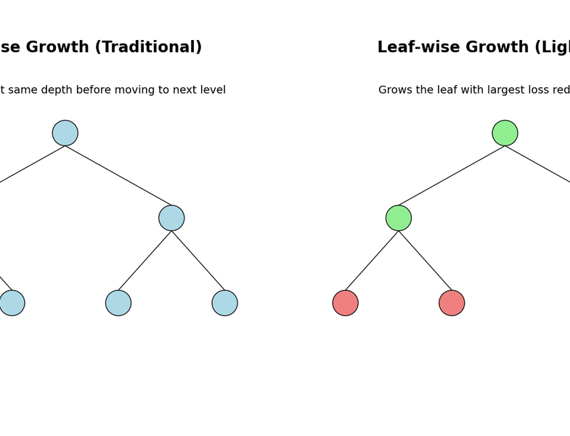
LIGHTGBM
What is LightGBM?
LightGBM is a gradient boosting framework developed by Microsoft Research in 2017, designed to be faster and more memory-efficient than XGBoost while maintaining comparable or better accuracy.
The name "Light" refers to its ability to handle large-scale datasets with significantly lower memory usage and faster training time. It achieves this through two novel techniques: Gradient-based One-Side Sampling (GOSS) and Exclusive Feature Bundling (EFB).
Unlike XGBoost's level-wise (horizontal) tree growth, LightGBM uses a leaf-wise (vertical) growth strategy. This means it grows the tree by splitting the leaf with the highest loss reduction, leading to deeper, more asymmetric trees that often achieve lower error.
LightGBM supports categorical features natively — no one-hot encoding needed. It uses a special algorithm called Fisher's method to find optimal splits for categorical variables, which is both faster and often more effective.
✦
GOSS
▣
EFB
▣
Native Categorical
ⓘ
Leaf-wise (LightGBM) vs Level-wise (XGBoost) tree growth strategy

Slide 19
LIGHTGBM
Key Innovations That Make LightGBM Fast
▦
GOSS — Gradient-based One-Side Sampling
▣
EFB — Exclusive Feature Bundling
Not all data points are equally useful. GOSS keeps all instances with large gradients (hard examples) and randomly samples from instances with small gradients (easy examples). This reduces the dataset size without losing much information about the decision boundary. A constant multiplier adjusts the sampled easy examples to maintain the original gradient distribution. Result: up to 3× faster training with minimal accuracy loss.
Many features in real datasets are mutually exclusive (e.g., one-hot encoded categories). EFB bundles these exclusive features into a single feature, reducing the number of features without losing information. This reduces the feature dimension from millions to thousands, dramatically speeding up histogram construction.
✿
Leaf-Wise Tree Growth
▣
Native Categorical Support
Instead of growing trees level by level (like XGBoost), LightGBM grows the leaf that maximizes loss reduction. This creates deeper, asymmetric trees that fit the data better. Risk: can overfit on small datasets — use num_leaves to control.
No need for one-hot encoding! LightGBM uses an optimal partitioning algorithm for categorical features. It finds the best way to split categories by reordering them based on gradient statistics. This saves memory and often improves accuracy.

Slide 20
COMPARISON
LightGBM vs XGBoost — Head to Head
Dimension | XGBoost | LightGBM
Tree Growth Strategy | Level-wise (breadth-first) — grows all leaves at each level | Leaf-wise (depth-first) — grows the leaf with highest gain
Training Speed | Fast, but slower than LightGBM on large data | 2–10× faster due to GOSS, EFB, and histogram-based splits
Memory Usage | Higher — stores full feature values | Lower — histogram-based, bins continuous features
Categorical Features | Requires one-hot or label encoding | Native support — optimal partitioning algorithm
Overfitting Risk | Lower on small datasets (level-wise is conservative) | Higher on small datasets (leaf-wise can overfit)
Accuracy (Large Data) | Excellent | Comparable or slightly better
Accuracy (Small Data) | Often better | May overfit — use small num_leaves
Best Use Case | Small-to-medium datasets, production stability | Large-scale data, speed-critical applications

Slide 21
LIGHTGBM
Cheat Sheet
⚙
Critical Hyperparameters
⚙
LightGBM-Specific Params
◆
Practical Tips
num_leaves
Max number of leaves per tree (default 31). Key control on model complexity — lower for small datasets, higher for large.
feature_fraction
small data
Use small num_leaves (e.g., 15–31) and set max_depth explicitly.
Feature sampling ratio (0.5–1.0). Equivalent to XGBoost colsample_bytree.
large data
Let num_leaves be higher (63–255) and rely on min_data_in_leaf.
learning_rate
Step size (0.01–0.3). Same as XGBoost — lower is better with more iterations.
bagging_fraction
categorical
Use categorical_feature parameter instead of one-hot encoding for best results.
Row sampling ratio (0.5–1.0). Equivalent to XGBoost subsample.
n_estimators
Number of boosting rounds. Pair with early stopping.
missing values
lambda_l1 / l2
L1/L2 regularization (same concept as XGBoost).
LightGBM handles NaN natively — no imputation needed for most cases.
max_depth
Limits tree depth (default -1, unlimited). Set explicitly to prevent overfitting on small data.
cat_feature
List of categorical column indices. Enables native categorical handling.
monitoring
Use early_stopping_rounds and log_evaluation for monitoring.
min_data_in_leaf
boosting_type
Min samples per leaf (default 20). Higher = more conservative, prevents overfitting.
gbdt (default), goss, dart, or rf. GOSS for speed, DART for better accuracy on some tasks.

Slide 22
Which Boosting Algorithm Should You Use?
▿
AdaBoost
♛
XGBoost
⚡
LightGBM
Use when: You need a simple baseline, explaining boosting from scratch, or the dataset is clean and small.
Use when: Dataset is small-to-medium, you need production stability, or interpretability matters.
Use when: Dataset is large (100K+ rows), training speed matters, or you have many categorical features.
Skip when: You need speed, handle noise, or work with large data.
The safest default choice for most real-world problems.
Dominates Kaggle for tabular data with proper tuning.

